Slide 1

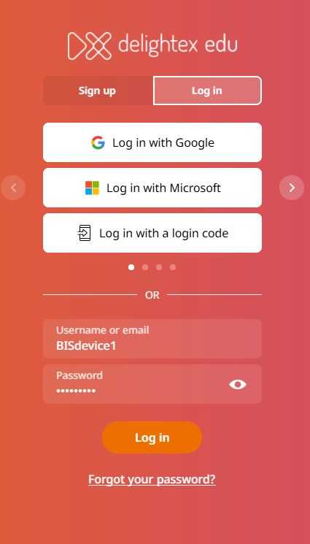
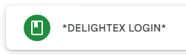
Astronaut Control: Space Programming Adventure
Learning Objectives
Using Gravity & Velocity in space (VR)
Starter Task:
Login into laptop
Open the Delightex Link
Sign in with your Device
e.g BISDEVICE1

Slide 2
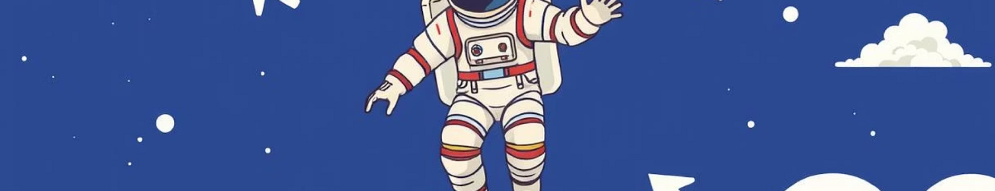

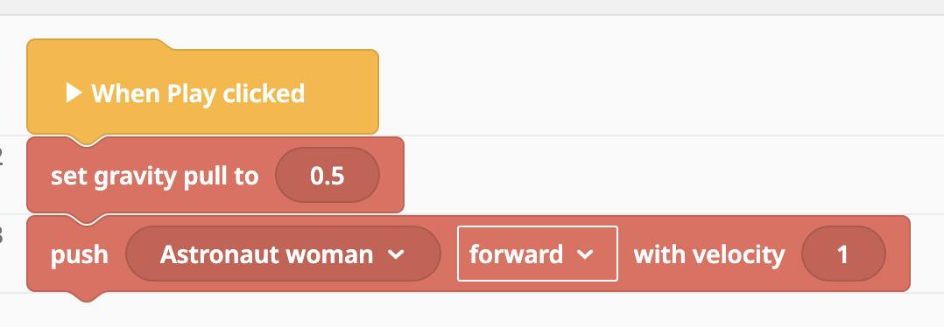
Understanding Physics
What is Gravity?
Gravity = The force that pulls things down
In our code: set gravity pull to 0.5
What do the numbers mean?
0 = No gravity (floating in space!)
0.5 = Weak gravity (slow, floaty like the moon) ← We use this!
1 = Normal gravity (like Earth)
2+ = Strong gravity (falls fast)
What is Velocity?
Velocity = How fast and which way something moves
Think of it like a speedometer in a car - but it also knows if you're going forward or backward
Higher numbers = faster movement (velocity 5 is faster than velocity 1)
Velocity 0 = stopped (not moving at all)
Notes:
Gravity = The force that pulls things down
In real life, gravity makes things fall to the ground
In our game, we control how strong gravity is!
In the image:
set gravity pull to 0.5
What do the numbers mean?
0 = No gravity (floating in space forever!)
0.5 = Weak gravity (slow, floaty like on the moon)
1 = Normal gravity (like Earth)
2 or higher = Strong gravity (falls fast and heavy)
Why do we use 0.5?
Makes the astronaut feel like they're in space
Jumping feels floaty and fun
Landing is gentle, not a hard crash
Try it: Change 0.5 to 2 and see how your astronaut becomes much heavier and falls faster!

Slide 3
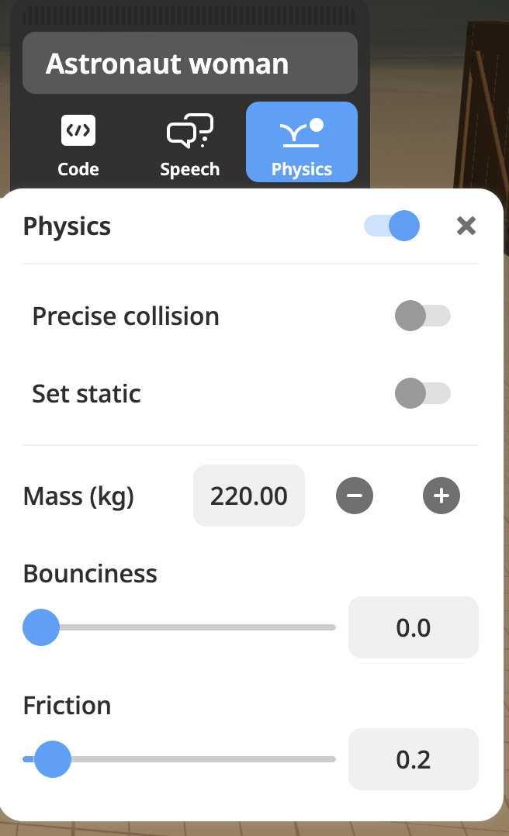
Understanding Physics
BOUNCINESS ⚽
How much something bounces when it hits something else
The astronaut has 0.0, so she won't bounce - she'll just land and stay put
MASS (kg) 🏋️
How heavy something is
The astronaut woman at 220kg is quite heavy - like 3 adults on earth
FRICTION 🛝
How slippery or sticky the surface is
The friction is 0.2, so she'll slide a little bit but then slow down
Notes:
BOUNCINESS ⚽
How much something bounces when it hits something else
0.0 = no bounce at all (like a beanbag - it just stops)
1.0 = super bouncy (like a rubber ball)
Your astronaut has 0.0, so she won't bounce - she'll just land and stay put
MASS (kg) 🏋️
How heavy something is
Higher numbers = heavier objects
Heavy objects are harder to push and move slower
Example: Your astronaut woman at 220kg is quite heavy - like 3 adults!
FRICTION 🛝
How slippery or sticky the surface is
0.0 = super slippery (like ice - keeps sliding forever)
1.0 = very sticky/rough (stops quickly)
Your astronaut has 0.2, so she'll slide a little bit but then slow down

Slide 4
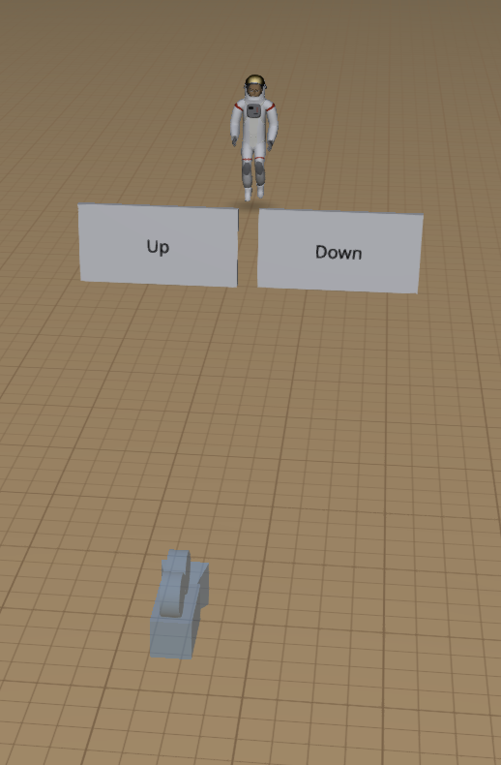
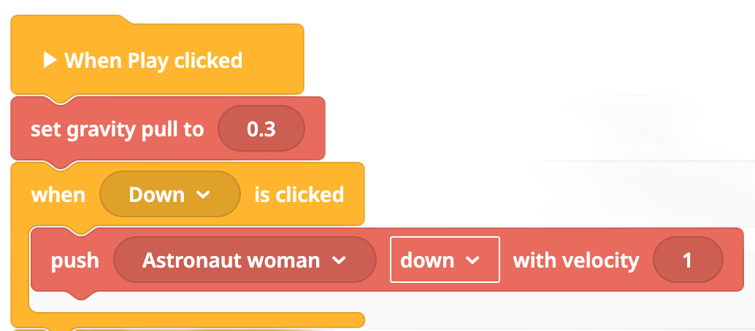
Task 1
Movement
Program your astronaut to move up and down using Events clicked for up and down
https://edu.delightex.com/QKF-VWF
Notes:
https://edu.delightex.com/QKF-VWF - Before you deploy this delete any code and update link - Code is there for model purpose . Or make a copy for students.

Slide 5
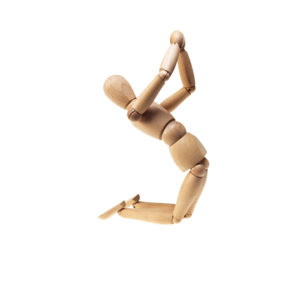
Stop falling over! Problem
The Problem: Your astronaut is like a toy with loose joints. When it jumps, it gets wobbly and falls flat.
Why does this happen?
In 3D games, characters can move AND spin in many directions
Without restrictions, your astronaut acts like a ragdoll
Every time it moves or jumps, it can tip, twist, and tumble!
https://edu.delightex.com/FZR-NQM
Notes:
Panning Movement (All Locked)
Our Setup: X ON, Y ON, Z ON
What happens when everything is ON?
Your astronaut pans instead of rotates - it slides around like a shopping trolley on ice!
The Shopping Trolley Analogy:
Imagine pushing a trolley across an icy car park
The trolley can slide forward, backward, left, and right
BUT it doesn't spin around - it always faces the same direction
That's exactly how our astronaut moves!
Why this works: ✅ No wobbling or tipping over ✅ Simple, smooth movement in all directions ✅ Always faces the same way (usually toward the camera) ✅ Easy controls for beginners!
Real-world example: Like sliding a book across your desk - you can push it anywhere, but it doesn't rotate!

Slide 6
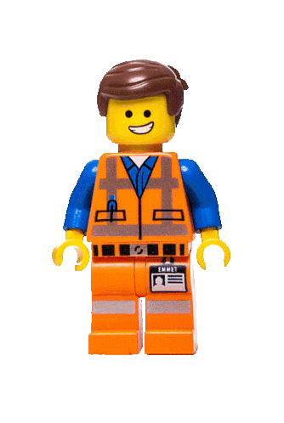
Stop falling over - Answer
The Solution: Panning (Locking All Rotations)
Think of it like this:
Without panning = Action figure with bendy joints (can fall over)
With panning = LEGO minifigure (always stands straight!)
What is panning? Panning means your character slides around but stays perfectly upright - like a skater gliding smoothly without spinning or falling.
Notes:
Panning Movement (All Locked)
Our Setup: X ON, Y ON, Z ON
What happens when everything is ON?
Your astronaut pans instead of rotates - it slides around like a shopping trolley on ice!
The Shopping Trolley Analogy:
Imagine pushing a trolley across an icy car park
The trolley can slide forward, backward, left, and right
BUT it doesn't spin around - it always faces the same direction
That's exactly how our astronaut moves!
Why this works: ✅ No wobbling or tipping over ✅ Simple, smooth movement in all directions ✅ Always faces the same way (usually toward the camera) ✅ Easy controls for beginners!
Real-world example: Like sliding a book across your desk - you can push it anywhere, but it doesn't rotate!

Slide 7
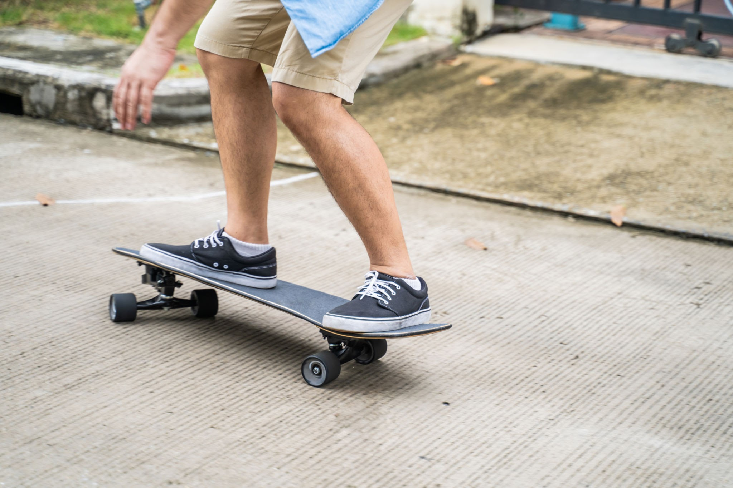
Panning Movement (All Locked)
Our Setup: X ON, Y ON, Z ON
What happens when everything is ON?
Your astronaut pans instead of rotates - it slides around like a shopping trolley on ice!
Imagine riding a skateboard across smooth ground
The skateboard can glide forward, backward, left, and right
BUT it doesn't flip over or spin around - it stays flat on the ground
You always face the same direction while you're sliding
That's exactly how our astronaut moves!
Notes:
Red Box = Make sure this is set on rotation - default is movement

Slide 8
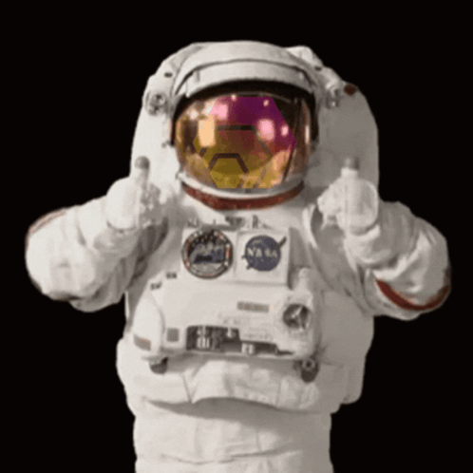
Movement Check
Can you move your astronaut in all directions?
Velocity Impact
What happens when you change velocity numbers?

Slide 9

Direction Movement + Stop
Your Mission:
Create control buttons for your astronaut:
Movement buttons: Up, down, left, right, forward, backward
Stop button: Sets velocity to 0 (makes astronaut stop moving)
Why do we need these? These buttons let you control your astronaut in 3D space - just like a video game controller!
Success Criteria: All directions work smoothly with stop control.

Slide 10
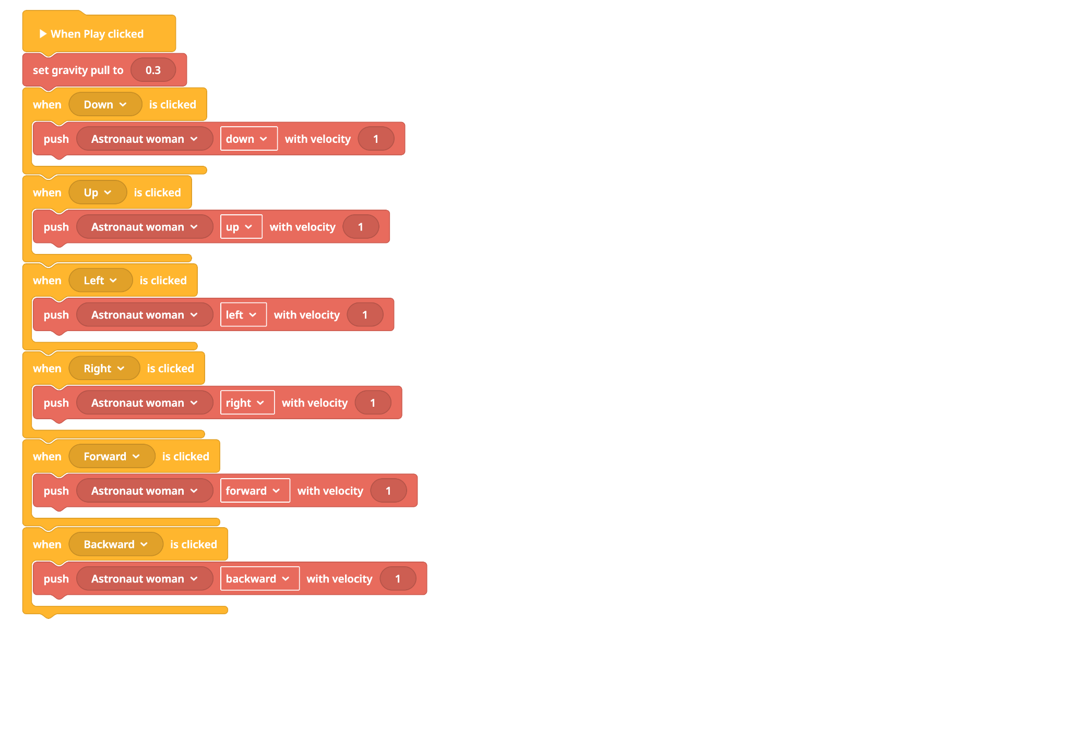
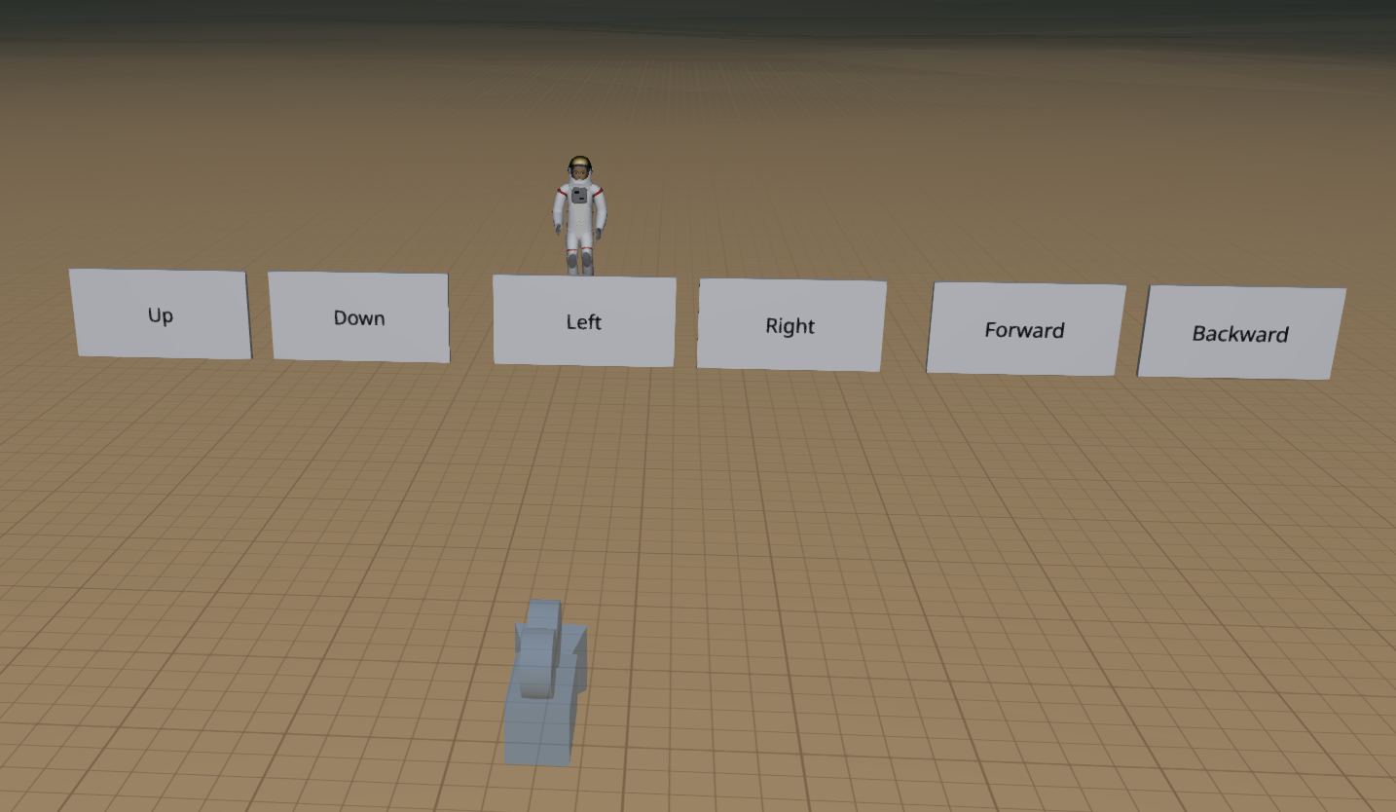

Slide 11
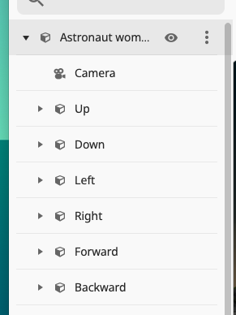
Extension
Connect your camera and buttons to the astronaut.
Make the camera follow the astronaut when they move — so it looks like you are moving through space!
Success Goal:
Be able to match the right parts together (like camera, controls, and astronaut).
Think about the perspective of the camera to the Astronaut as you move
Notes:
https://edu.delightex.com/FZR-NQM

Slide 12
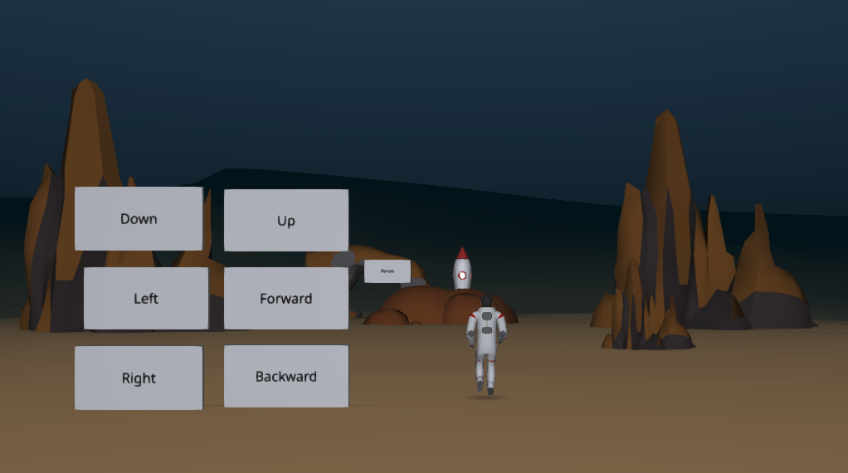
Attach your camera and buttons to the Astronaut to make it move with the camera
https://edu.delightex.com/FZR-NQM

Slide 13
Different Velocities & Friction
Add obstacles for your astronaut to move around.
Change how slippery or bouncy the surfaces are.
Change how fast your astronaut moves.
Success Goal:
Make your astronaut easier to control!
Notes:
https://edu.delightex.com/FZR-NQM

Slide 14

🛰️ Plenary: What Did We Learn Today?
✅ Key Learning:
Velocity:
We learned how changing speed and direction affects movement.
Physics/Friction: We changed how the ground feels to help the astronaut move more easily.
Camera Positioning:
We made the camera follow the astronaut to feel like we’re moving through space.

